Slide 1

Audiobooks by Audible
A web scraping project By James Welch

Slide 2
Background
Global audiobook market size was 2.67 billion in 2019 and is expected to compound by 25% per year
Audible is a publisher and distributor of audiobooks and podcasts, the largest in the U.S.
The company was founded in 1995 and acquired by Amazon in 2008.
Audible reports +200,000 audio programs and over a billion hours listened a year.
Currently Audible provides two pricing tiers at $7.95 and $14.95 per month.
Both tiers provide access to Audible Originals, the higher tier includes a monthly audiobook credit.

Slide 3
Amazon & Books
Author’s Journey
Amazon Publishing
Kindle Direct
Ala carte printing
Distribution
Audio Creation Exchange
Text to Audio
Distribution
Goodreads
Reviews
Organic Search
Amazon (Books)
Purchase
Reviews
Audible
Purchase
Reviews
Reader’s Journey

Slide 4
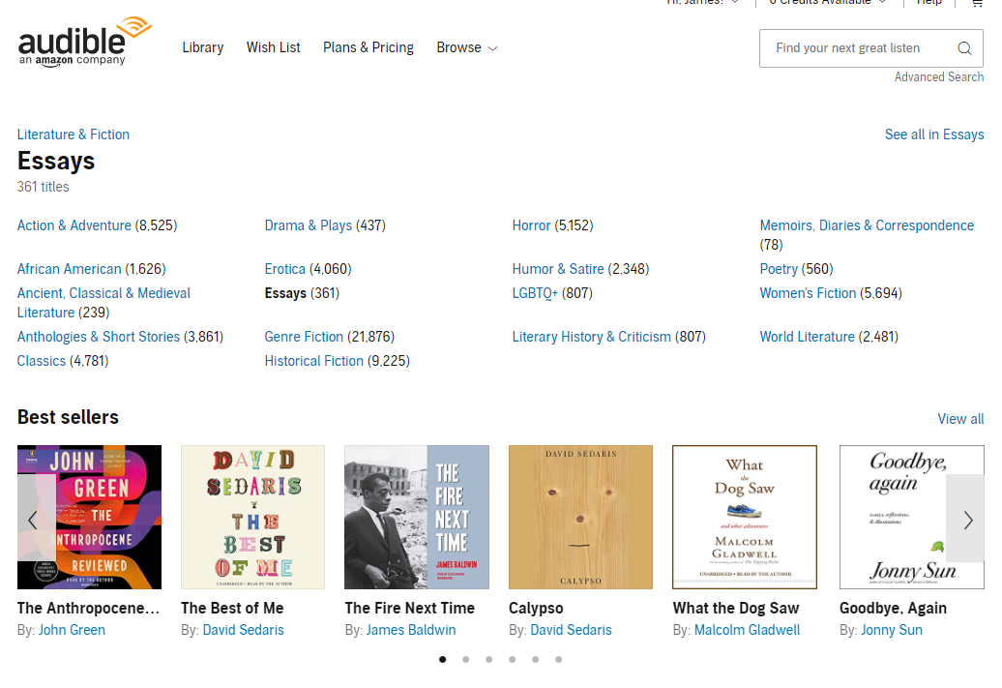
Category Scraping
Parent Category
Alt: Results Page URL
Category Name
Number of titles
Sub-Categories
Bold: No Sub-Categories
Results Page URL
Scrape Category Structure & Information
Link to Category Best Sellers
Scrape Title Information from Results Page

Slide 5
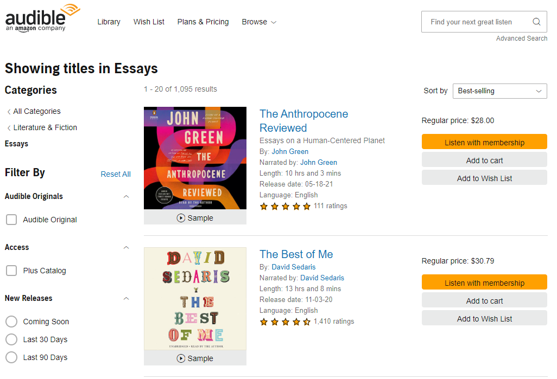
Title Scraping
Category Name
Title Information:
Title
Subtitle
Author
Narrator
Length
Language
Start Rating
Number Ratings
Price
Scrape Category Structure & Information
Link to Category Best Sellers
Scrape Title Information from Results Page

Slide 6
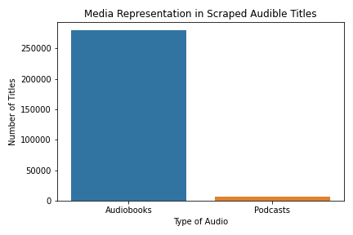
Collected Titles
622,065 titles scraped
279,240 unique audiobooks
6,960 incidentally scrapped podcasts.

Slide 7
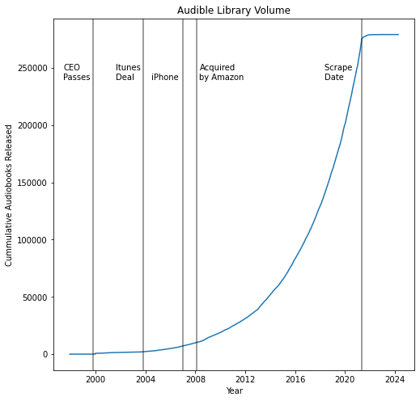
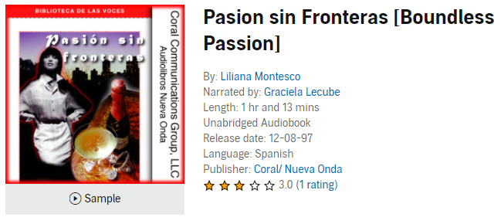
Growing Library
Since 2002, the number of titles in audibles library has been increasing yearly.
Several titles are listed years in advance
Most growth has been experienced since the iTunes deal and Amazon acquisition.
1st Release

Slide 8
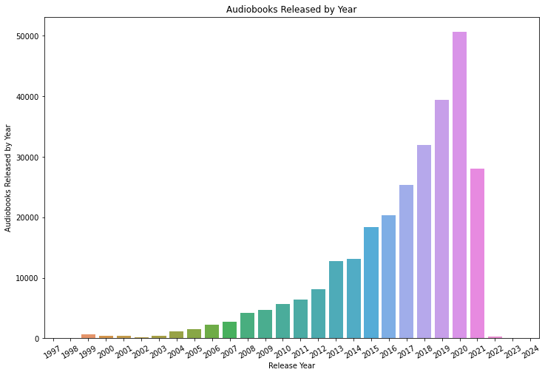
Growth
Since 2002, the number of titles in audibles library has been increasing yearly.
Several titles are listed years in advance
Most growth has been experienced since the iTunes deal and Amazon acquisition.
The best explanation for the equivalent growth in 2013-2014 is an influx from the ACX, founded in 2011.

Slide 9
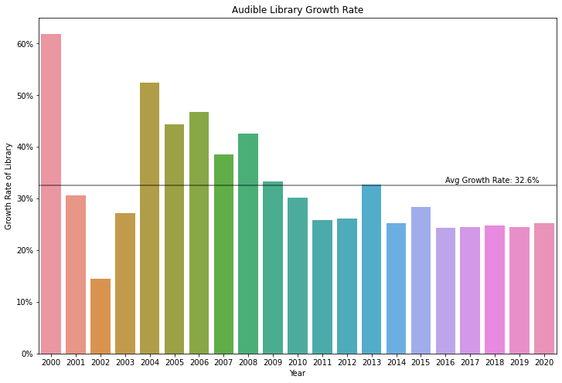
Consistent Yearly Growth
Yearly years are trimmed due to low numbers and high growth. (17 -> 700 in 1 year)
Recently, growth has stabilized around 24%
The increase in 2013 might be attributed to the creation & growth of ACX.
((Current Year – Previous Year ) / Previous Year) * 100 = Rate

Slide 10
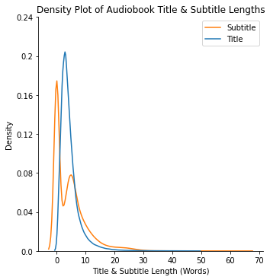

Title and Subtitle
Subtitles tend to be longer when present.
Most titles are 3 words.
While subtitles are generally 5 words.
60% of Audiobooks include a Subtitle.

Slide 11
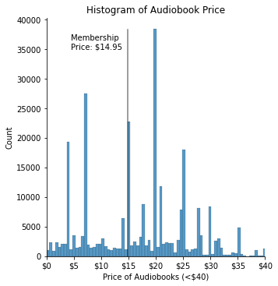
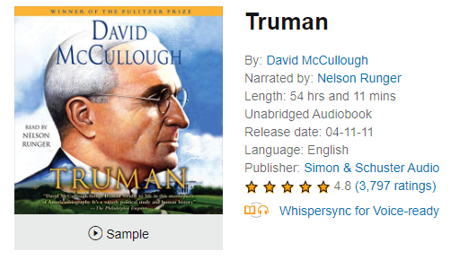
Price
Full Audible Membership: $14.95 / month.
57% of audiobooks are more expensive
A La Carte Price | Number of Audiobooks
$19.95 | 35103
$6.95 | 24551
$14.95 | 22088
$3.95 | 16737
$24.95 | 15953
$115.95
2539 audiobooks excluded

Slide 12
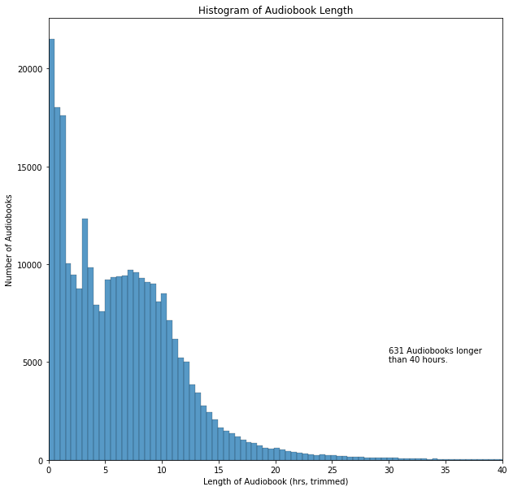
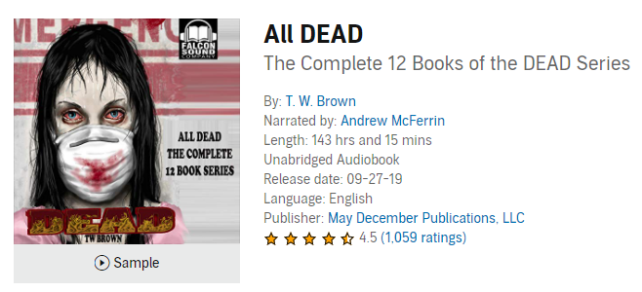
Length
Median audiobook length is 6 hours with a long tail.
Lengths determined lazily
Longest audiobook clocks in at 143 hours

Slide 13
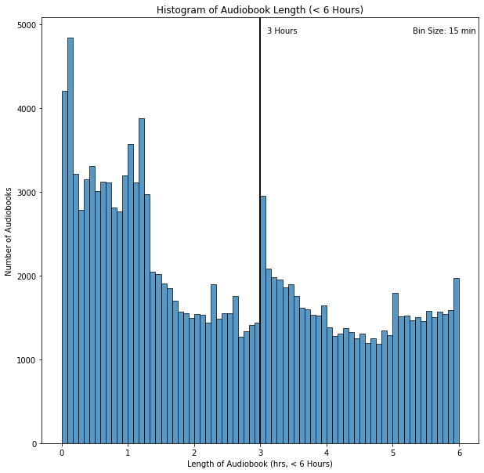
3 hours: deep dive
A Y combinator blog reported 3 hours as the cutoff for a royalty increase.
Prices are set by distributing platform, but ACX has an expected pricing table.
1-3 hours: $6.95
3-5 hours: $14.95
5-10 hours: $19.95
No evidence for differences in royalty rate

Slide 14
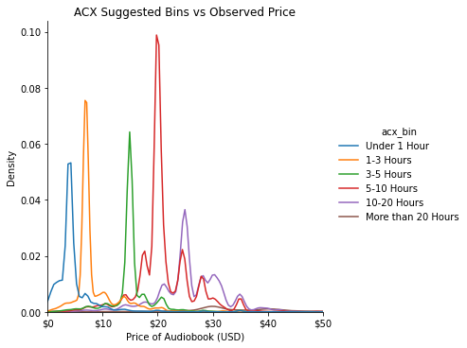
Price & Length
Length (Hours) | ACX suggested | Observed Pricing
< 1 | < $7 | $3.95
1 – 3 | $7 – $10 | $6.95
3 – 5 | $10 - $20 | $14.95 *
5 – 10 | $15 - $25 | $19.95
10 – 20 | $20 - $30 | $24.95
20+ | $25 - $35 | $29.95
* Audible Monthly Membership Price

Slide 15
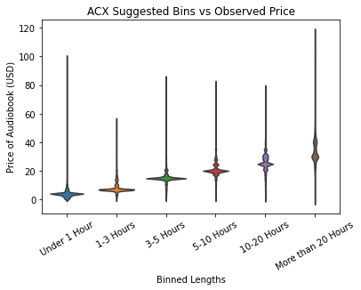
Price & Length
Length (Hours) | ACX suggested | Observed Pricing
< 1 | < $7 | $3.95
1 – 3 | $7 – $10 | $6.95
3 – 5 | $10 - $20 | $14.95 *
5 – 10 | $15 - $25 | $19.95
10 – 20 | $20 - $30 | $24.95
20+ | $25 - $35 | $29.95

Slide 16
Price & Length

Slide 17
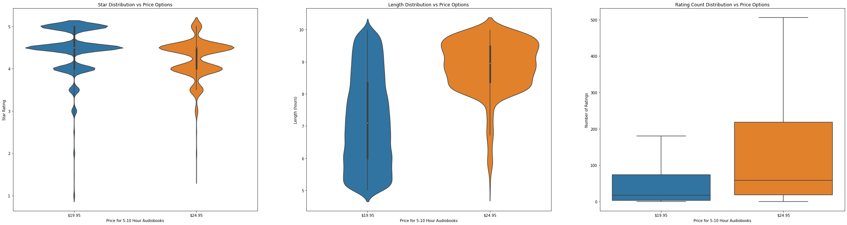
Price & Length
While books lengths are binned together, they are assigned different prices. Comparing $19.95 & $24.95 from the 5-10hr bin. We can see that the main differences are the length and number of reviews.

Slide 18
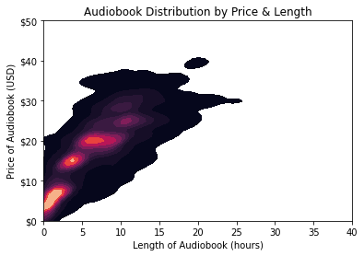
Price & Length
Price and Length are weakly positively correlated.
Hot-spots agree with ACX reported pricing
Linear Modeling to understand relationship with other variables.

Slide 19
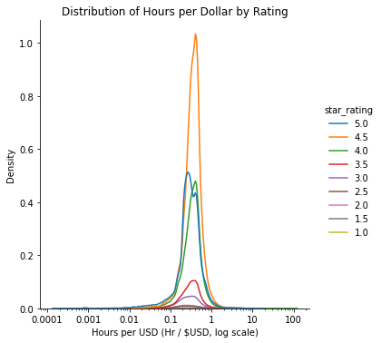
Bang for buck?
Consumers might be evaluating audiobooks based on how much they get per dollar.
The distribution of hrs/USD is nearly identical across star ratings.
Due to the separation between payment and ‘purchase’, price comparisons are weakly weighted.

Slide 20
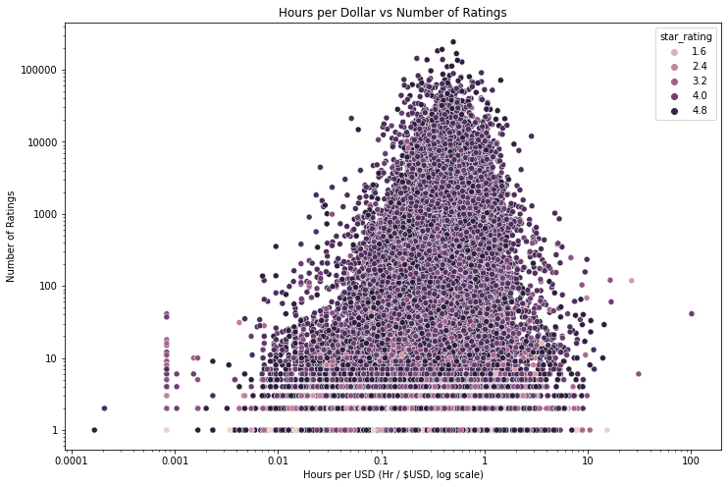
Bang for buck?
Consumers might be evaluating audiobooks based on how much they get per dollar.
The distribution of hrs/USD is nearly identical across star ratings.
Due to the separation between payment and ‘purchase’, price comparisons are weakly weighted.

Slide 21
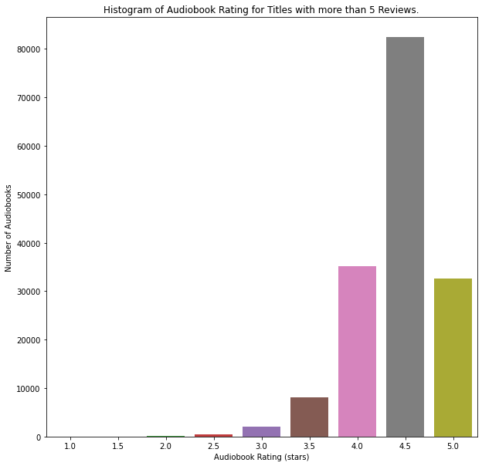
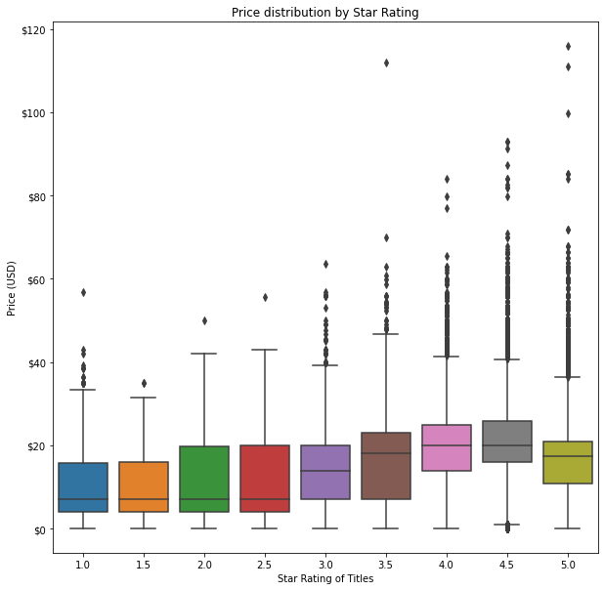
Ratings & Reviews

Slide 22
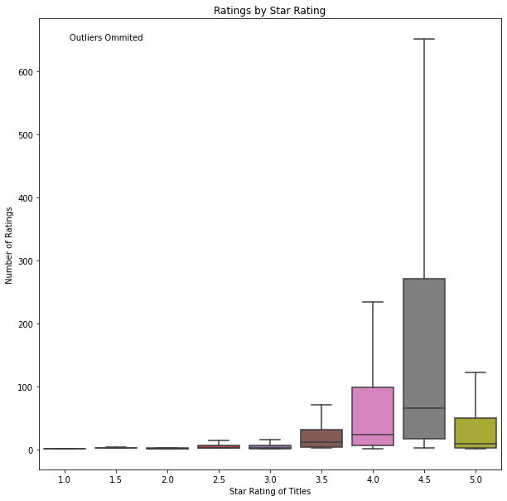
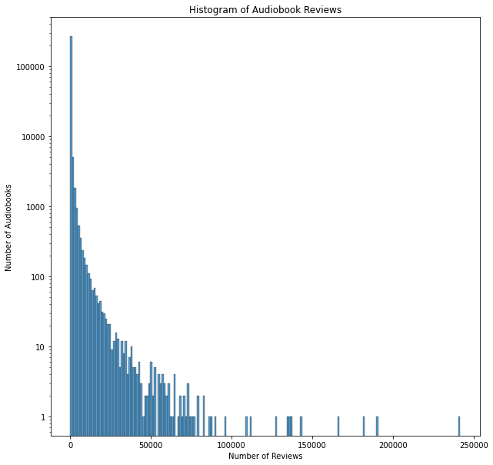
Ratings & Reviews
Ready Player One
Where the Crawdads Sing
Born a Crime
Becoming

Slide 23
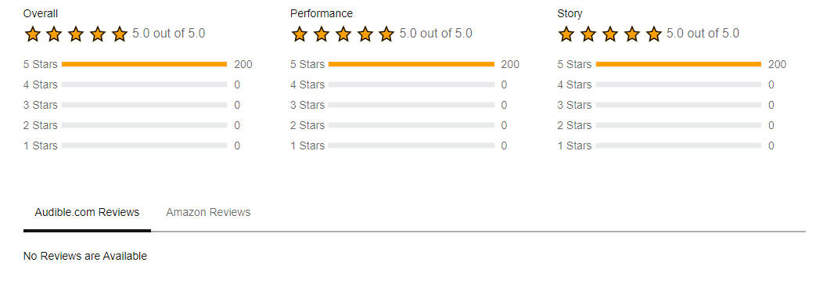
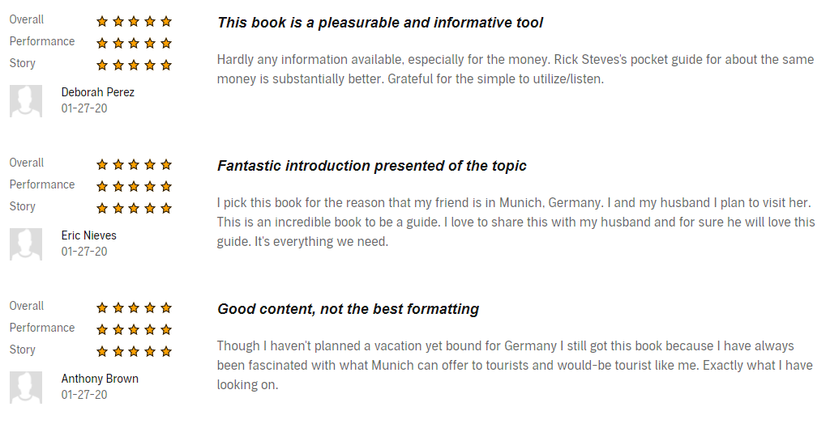
Ratings & Reviews

Slide 24
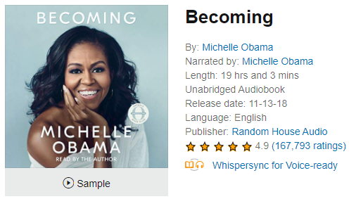
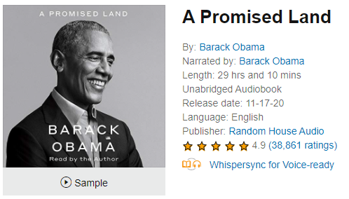
Obama vs. Obama
Authors can opt to narrate their own audiobooks instead of paying or sharing revenue with a producer (voice actor).
This is popular with memoirs and for celebrities.
Are these books different? Are they becoming more popular?
Yes
Oprah’s
Book Club?
No

Slide 25
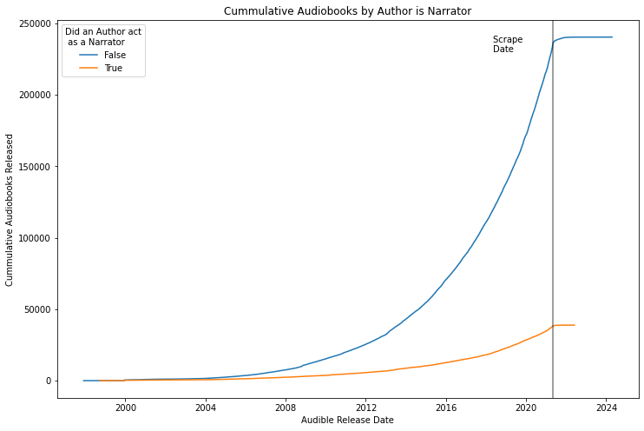
Author as Narrator
Authors have been self-narrating since 1998.
The growth of this trend loosely mirrors that of the overall library.
No distinct advantage across ratings, price, length, or listing.

Slide 26
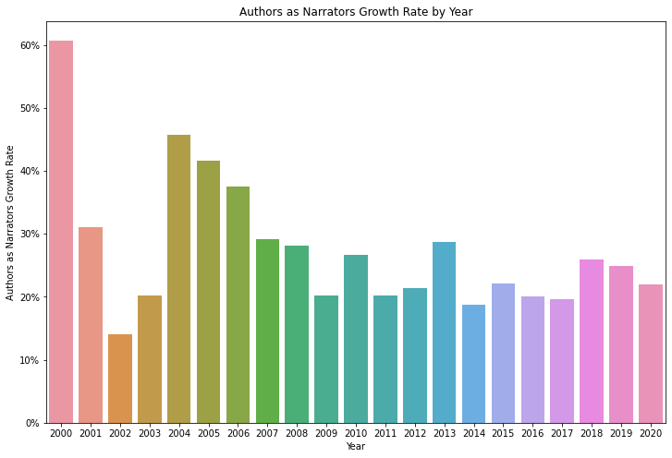
Author as Narrator
Authors have been self-narrating since 1998.
The growth of this trend is slightly lower than that of the overall library.
No distinct advantage across ratings, price, length, or listing.

Slide 27
Author as Narrator vs Library Growth

Slide 28
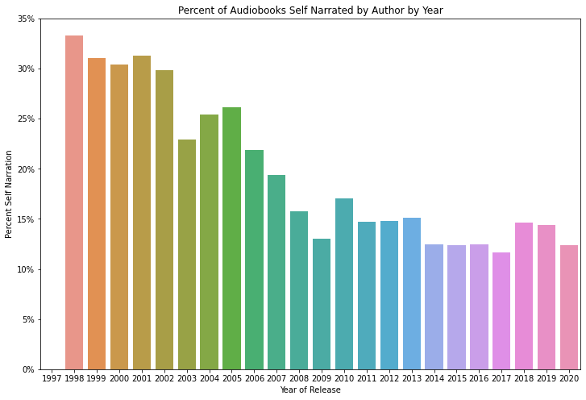
Author as Narrator
As a percentage, Self-Narration has been decreasing.
In the past decade, it has appeared to stabilize.
Audible originals and translations will further erode this trend.

Slide 29
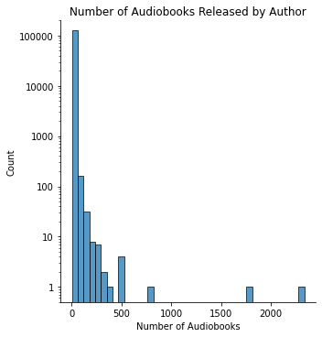
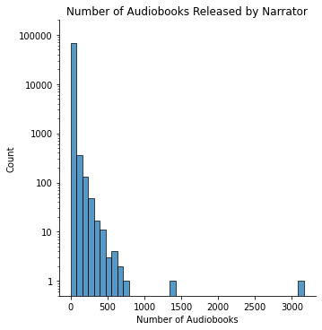
Authors & Narrators
Notes:
127289 Authors (some are working on the same books)
70048 Narratos

Slide 30
Prolific Authors
Authors | Number of Audiobooks | What’s their Deal?
J. M. Gardner | 2338 | Languages
Charles River Editors | 1755 | History
Innovative Language Learning | 812 | Languages
Pimsleur | 521 | Languages
div. | 501
William Shakespeare | 500 | Public Domain
The Great Courses | 499 | History
Captivating History | 366 | History
Greater Than a Tourist | 351 | Travel
James Patterson | 305 | Prolific

Slide 31
Prolific Narrators
Narrators | Number of Audiobooks | What’s their Deal?
“ ” | 3164
Full cast | 1256 | Collection
Uncredited | 717 | Collection
Scott Brick | 670 | Individual
Al Kessel | 636 | Individual
Cassandra Campbell | 617 | Individual
Simon Vance | 586 | Individual
Intuitive | 567
div. | 566
Pimsleur | 521 | Company

Slide 32
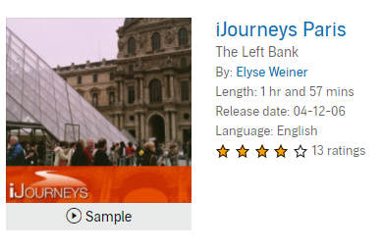
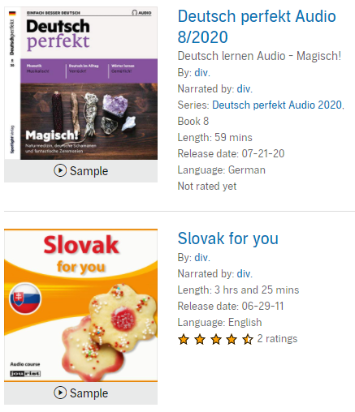
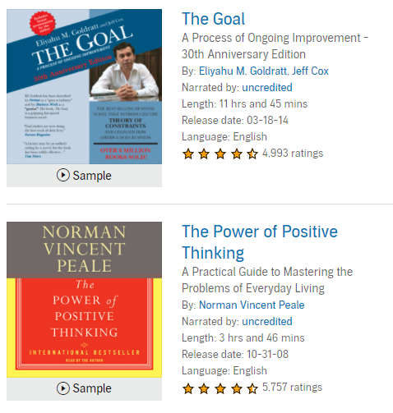
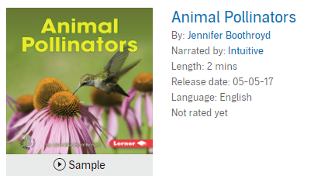
Authors & Narrators

Slide 33
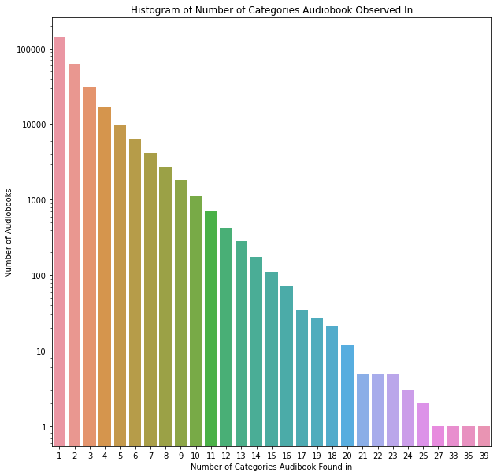
Categories
Categories appear to function like tags rather than bins.
More than half of all audiobooks are in only 1 category.
History seems to be favor for a high number of cross-listings.
# Categories | Title
39 | Bloodlands: Europe Between Hitler…
35 | Alone Together: Why we expect…
33 | Hitler: A Global Biography
27 | Chernobyl: The history of a Nuclear…
Notes:
Alone Togeather
['Philosophy', 'Workplace Culture', 'Workplace & Organizational Behavior', 'Technology & Society', 'Content Creation & Social Media', 'History & Culture', 'Computers & Technology', 'Aging & Longevity', 'Adolescent Psychology', 'Adulthood & Aging', 'Child Psychology', 'Compulsive Disorders', 'Social Psychology & Interactions', 'Developmental Psychology', 'Anxiety Disorders', 'Mood Disorders', 'Mental Health', 'Education & Learning', 'Popular Culture', 'Media Studies', 'School-Age Children', 'Teenagers', 'Dysfunctional Families', 'Fatherhood', 'Motherhood', 'Parenting & Families', 'Friendship', 'Marriage & Long-Term Partnerships', 'Grief & Loss', 'Communication & Social Skills', 'Philosophy', 'Society', 'History & Philosophy', 'Science', 'Science & Engineering']

Slide 34
Categories: Greatest (& Worst) Hits
Star Rating
Math
Christian Living
Ministry & Evangelism
Turkish
Slavic Languages
Hebrew
Total Ratings
All Categories
Suspense
Genre Fiction
Turkish
Serbo-Croatian
Flowers & Plants
Length
Americas
Politics & Activism
Epic
Flowers & Plants
Beginner Readers
Nursery Rhymes
Price
Americas
Politics & Activism
Politics & Government
Flowers & Plants
Nursery Rhymes
Beginner Readers
Languages
Southeast Asian Languages
Chinese Languages
French
Step Parenting & Blended Family
Thanksgiving
Amish & Mennonite
Titles
Action & Adventure
Anthologies & Short Stories
Historical
Adventurers & Explorers
Sexuality & Sexual Health
Latin

Slide 35
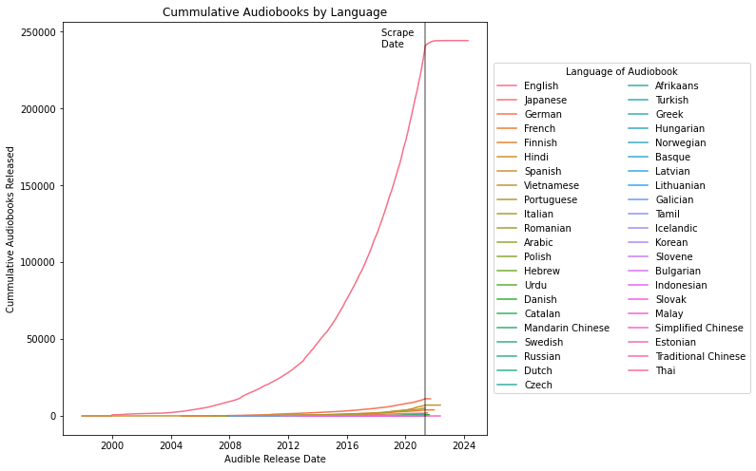
Language
44 languages are represented in Audible’s library.
English being the most common language.
Surprisingly, recent growth doesn’t seem to be reflected in other languages.
Netflix has recently partnered with hundreds of dubbing studios to add alternate language options.

Slide 36
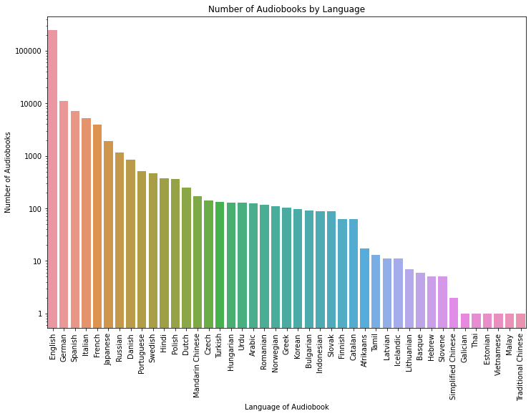
Language
44 languages are represented in Audible’s library.
English being the most common language.
Surprisingly, recent growth doesn’t seem to be reflected in other languages.
Netflix has recently partnered with hundreds of dubbing studios to add alternate language options.
*
*
*

Slide 37



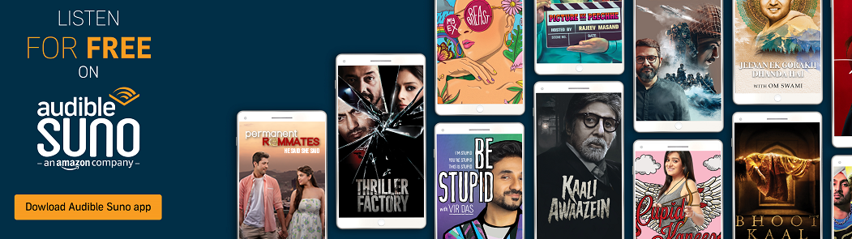
Lingua Franca
Audible has targeted landing pages for Chinese, Spanish, and Indian. All titles in scraped library
Audible Suno is a free Audible Originals Offering
This ‘targeted’ strategy still excludes the 82% of Audible titles (conservatively).
Non-English titles tend to do worse. They are shorter, cheaper, and garner fewer reviews.

Slide 38
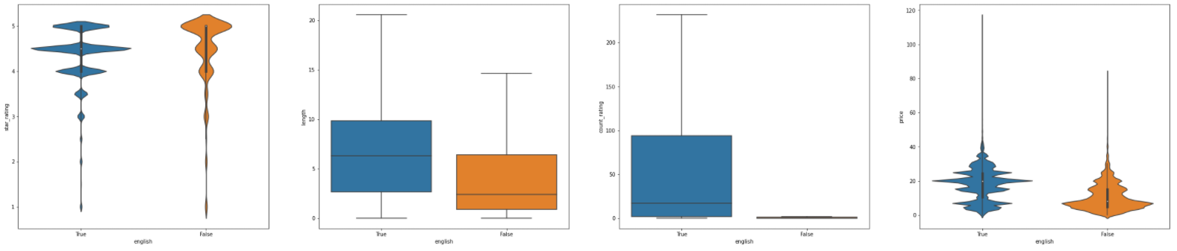
Lingua Franca
Non-English titles tend to be shorter, sell for less, and garner fewer reviews. There seem to be more 5-star reviews however that is likely due to the low review count.

Slide 39
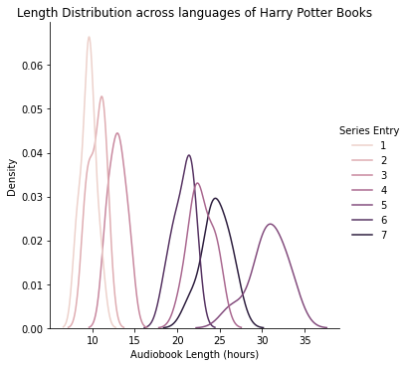
Translation: Bottom-Up
I attempted to impute if a translation was available by examining the variance of the same material across languages.
I used the translations of each entry in the Harry Potter Series and took the average of the percent standard deviation of the length (7.4%).
Unfortunely this led to many false negatives.

Slide 40
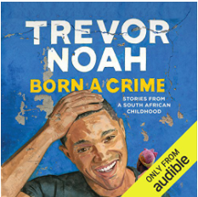
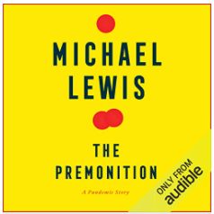

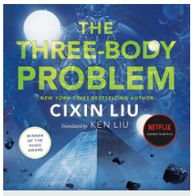
Translation: Top-Down
Audible already acts as producer so must have some audio rights.
These could be leveraged into additional languages with the same fixed cost / language.
Standard production costs are $200 / finished hour.
Price could be reduced via revenue sharing or exclusive deals with creators/studios

Slide 41
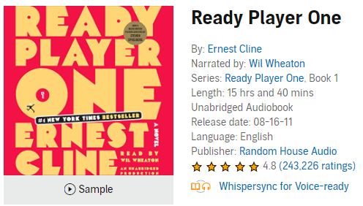
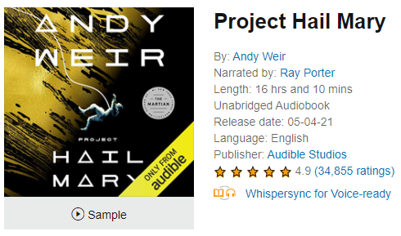
Conclusions
Past
Present
Future
All Time Most Reviewed
Top Seller
My First Audiobook
Audible Originals
Make the market
Most Recent Listen
Expansion
Grow the market
Thanks Ken Liu

Slide 42
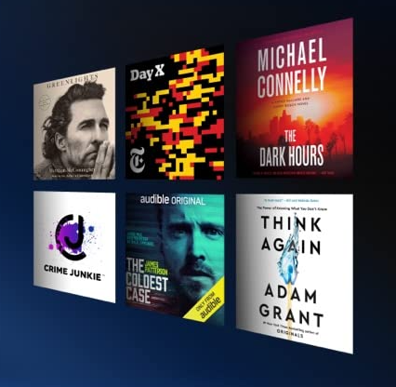

Conclusions
All Audible data is skewed
Price and Length appear correlated
Audible has 44 languages available but has few titles available in growing languages.
Audible is behind on translation which will be the main source of growth in the future.

Slide 43
Future Work
Dig Deeper
Podcasts & Audible Originals
Category Analysis
Notes:
Category information
Podcasts
Audible data collection could be expanded by fine grain review data.
More creative graphs
Better formatting in the notebook
Felt like I couldn’t find a through line
Capture plus vs premium plus titles?
Audible might have dynamic categories. Number of titles increased and decreased across categories.

Slide 44
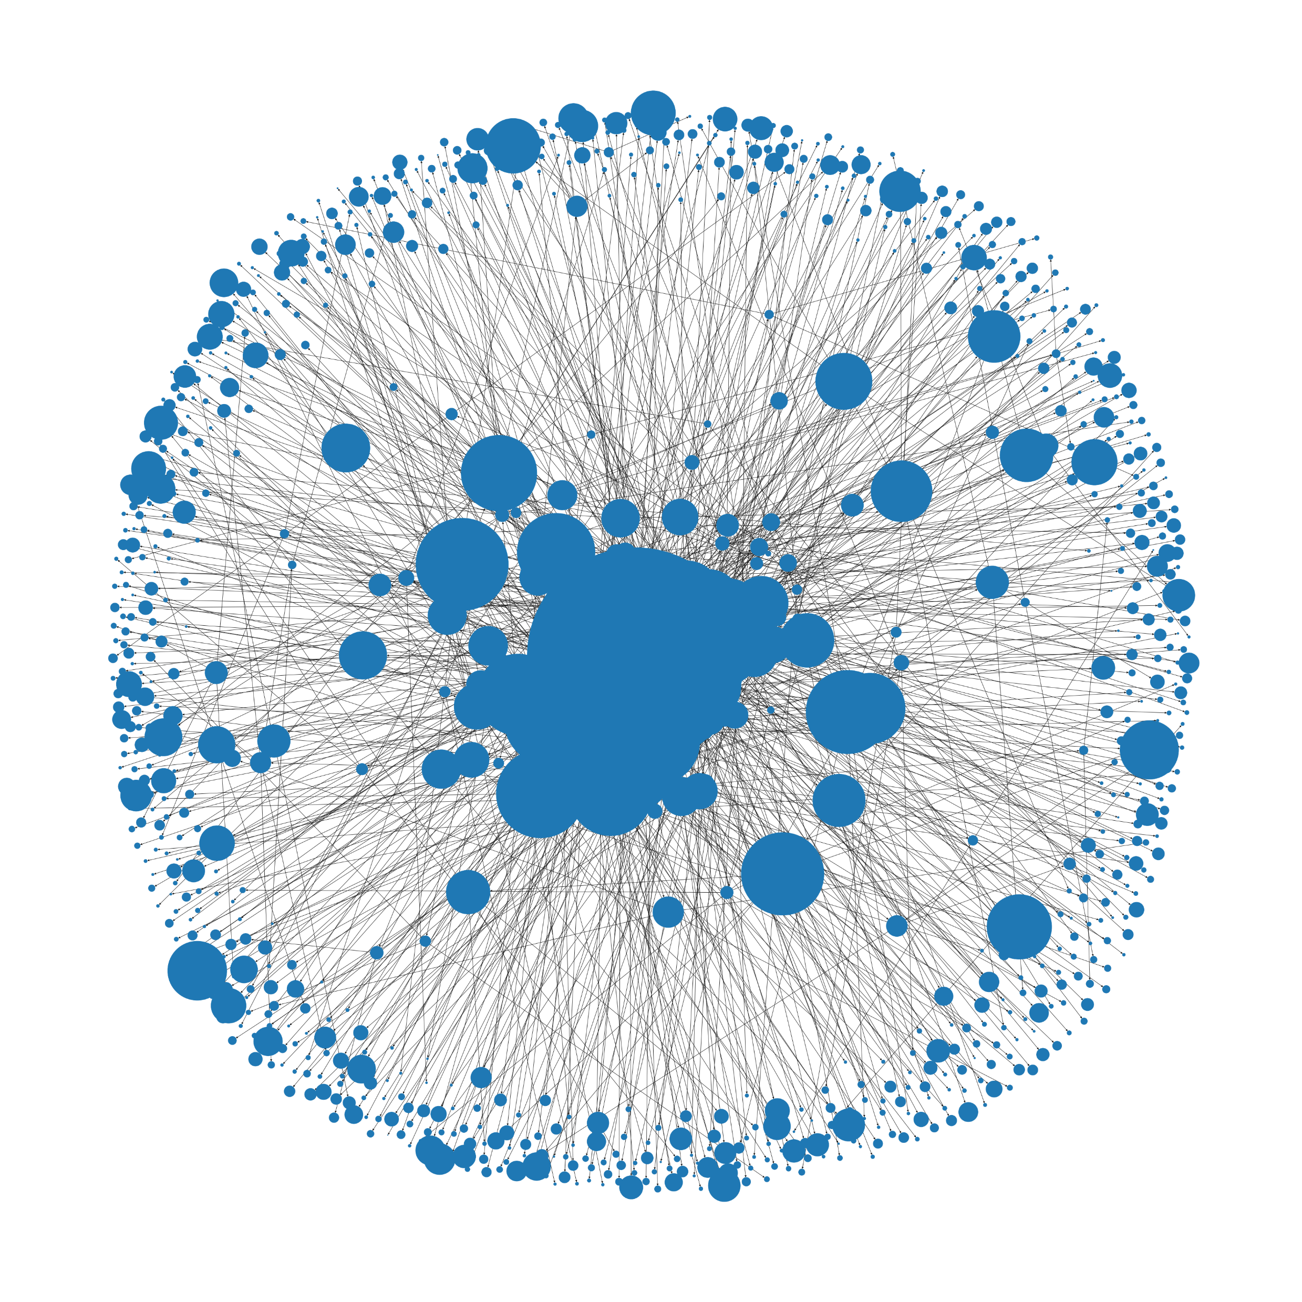
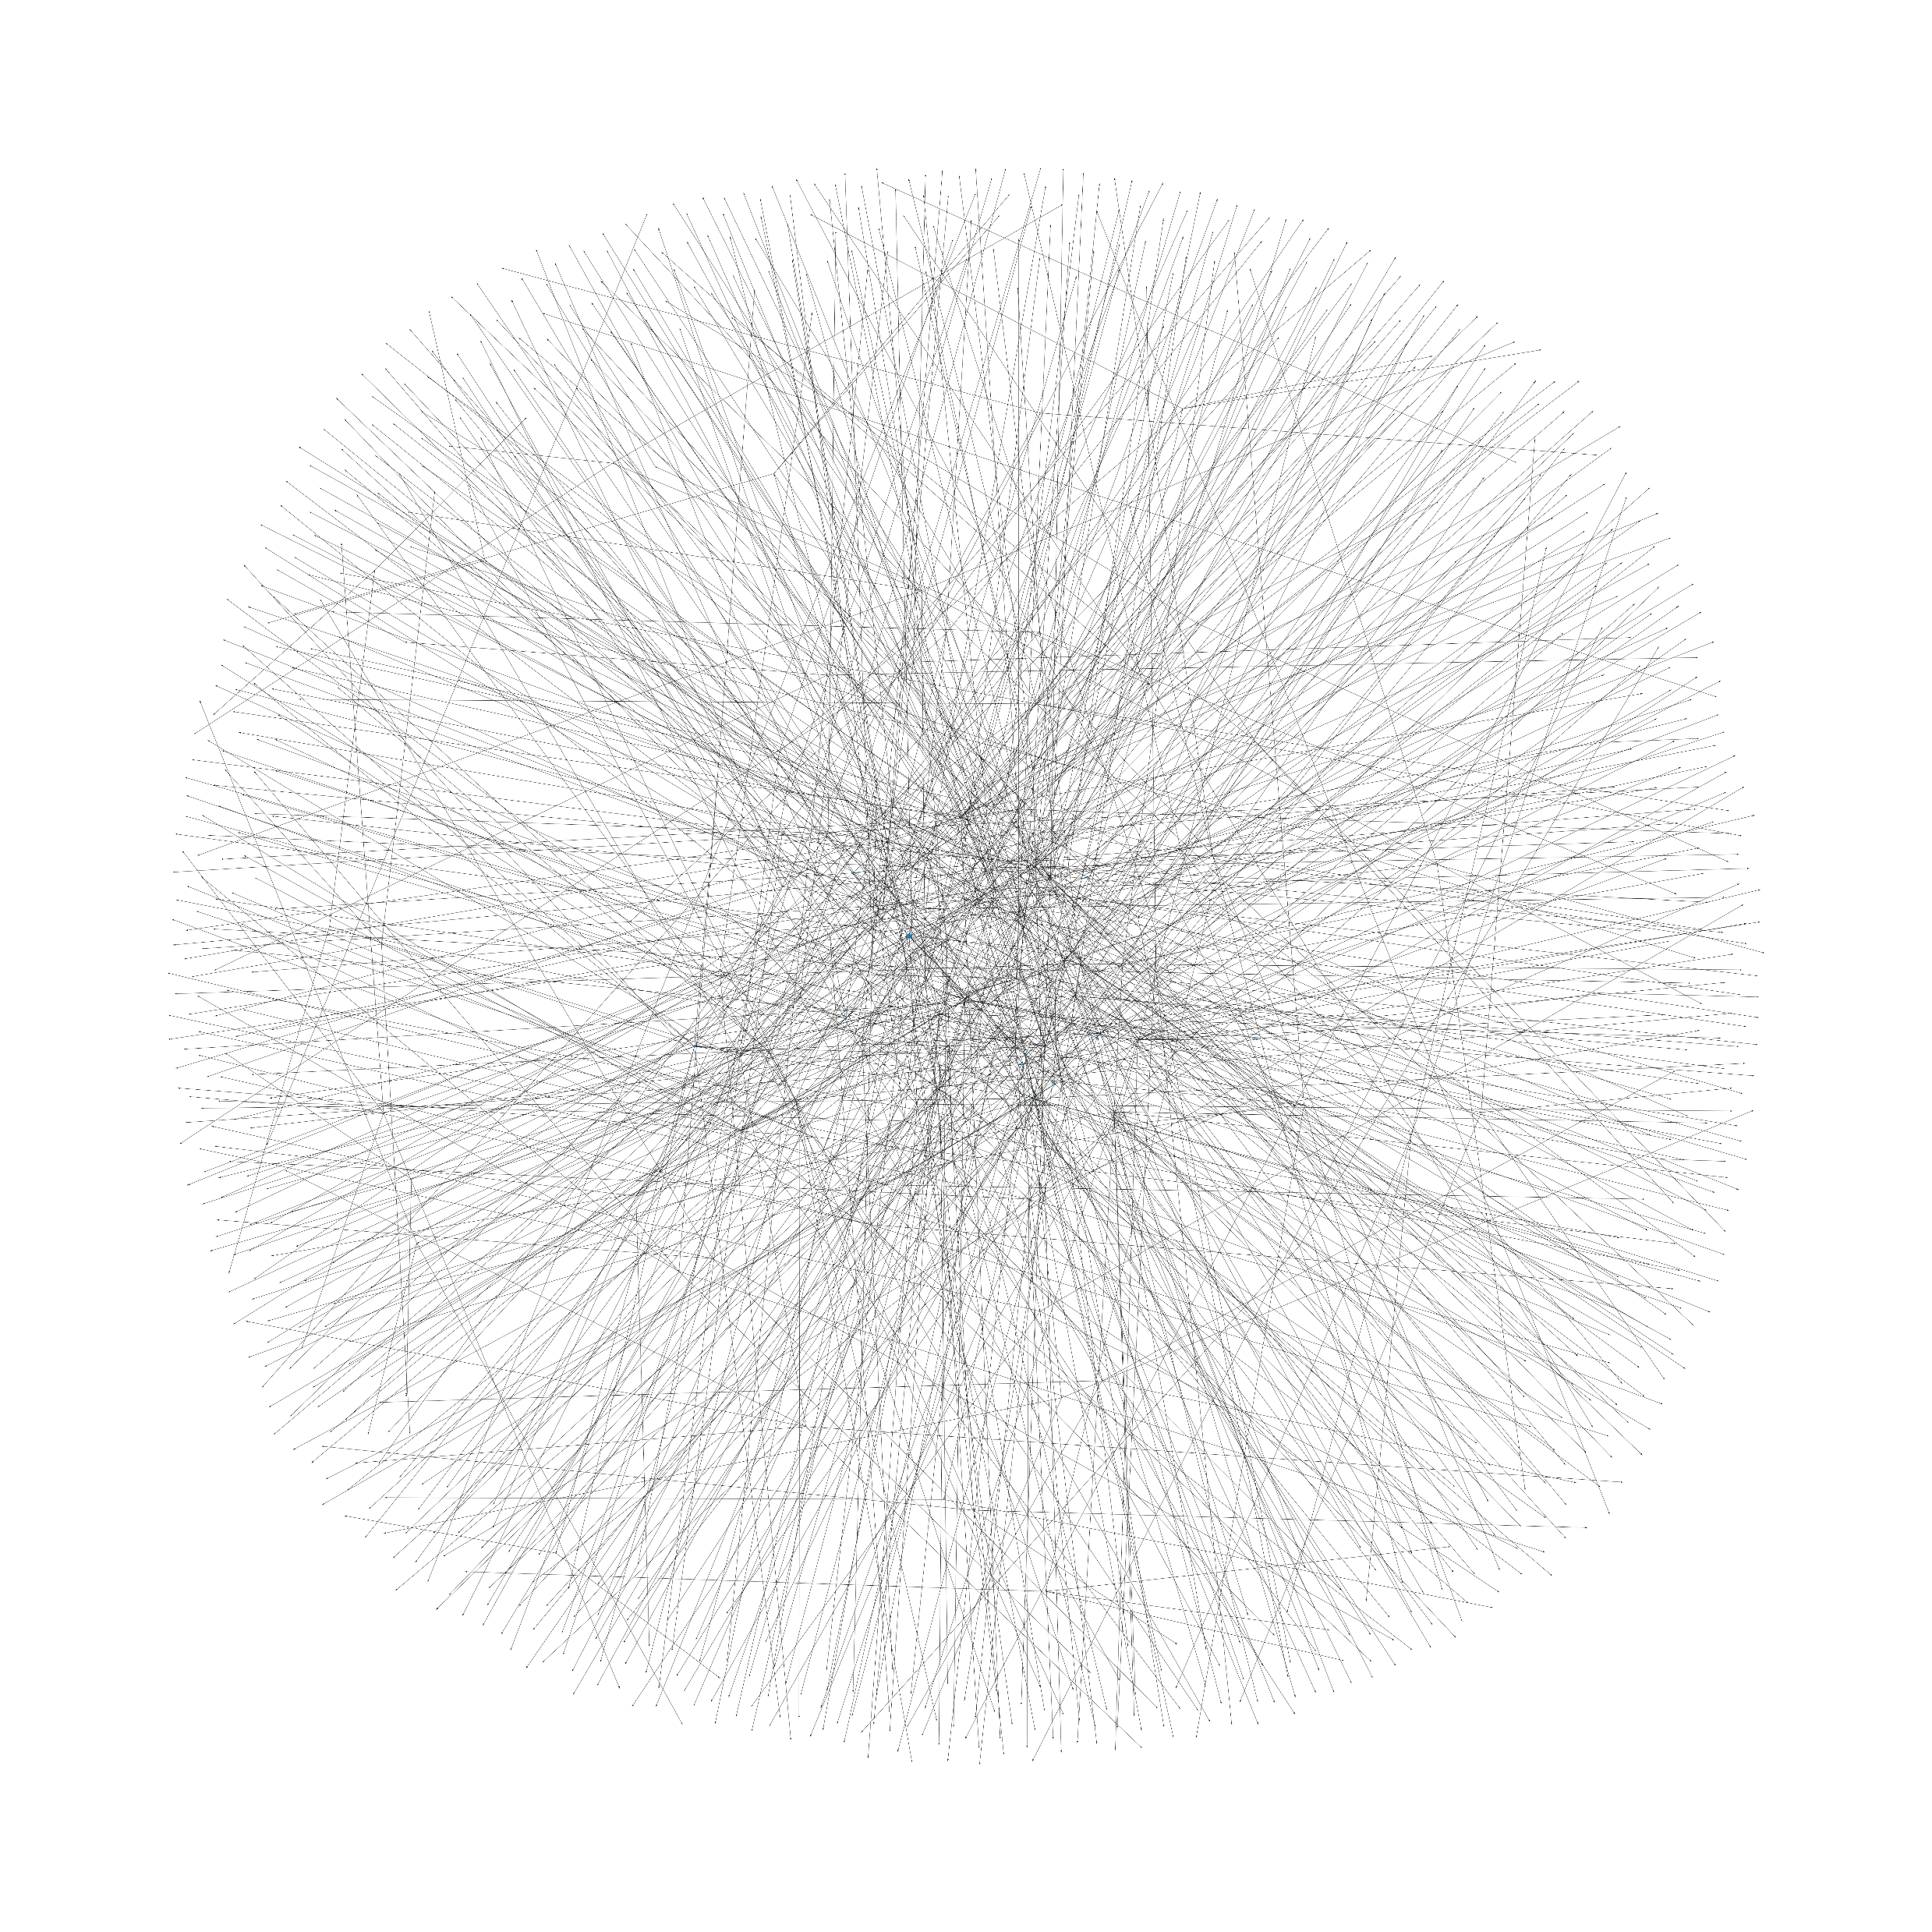
Future Work: Categories

Slide 45

Future Work
Attempted to scrape Amazon books
Roadblock: CAPTCHA after 500 page visits
Solution: ScraperAPI proxy service
Alternative Approach
Bookshop.org
Similar selection & data
Prices are slightly elevated

Slide 46
Acknowledgements
Audible for not banning me; screenshots
ScraperAPI for help which I didn’t end up using in this project.
Ed Robertson & Unsplash for the photo.

Slide 47

Questions?

